Slide 1
Certification of the production quality system
Prepared by:Suleimenova A
Checked by: Tastanbekov D.

Slide 2
Obstacles
1. The low technical level and quality of products supplied to the civilian sphere of consumption, due primarily to the lack of competition
2. The outdated material and technical base of production, which does not allow counting on successful activity in a free market.
3. Deformation of the production structure with the dominance of large and medium-sized enterprises and the almost absence of small enterprises adapted to respond quickly to market changes.
4. A rigid centralized system for planning logistics and distribution of products is often without due regard to production costs and the impact on the final results of enterprises.

Slide 3
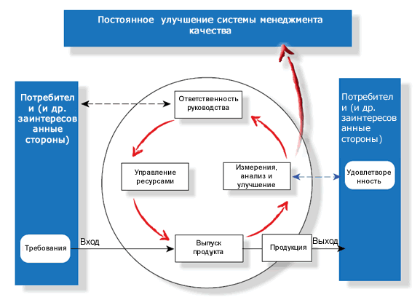

Slide 4
Certification of quality systems is carried out in the following sequence:
1. Pre-certification phase
2. The stage of preliminary assessment of the quality system
3. Verification and evaluation of the quality system in the organization
4. Inspection of a certified quality system

Slide 5
The pre-certification stage includes:
1. Registration of the applicant's application with the certification body for quality systems
2. Transfer to the applicant a set of source documents
3. Submission by the applicant to the certification body of the main documents of the quality system
4. Notification of the applicant about the acceptance of the order for certification or refusal about it
5. Preparation and execution of a contract for a preliminary assessment of the quality of the quality system
6. Formation of a quality system certification commission

Slide 6
Verification and evaluation of the quality system includes:
-Preliminary meeting
-Inspection of the auditee
-Drafting of the audit report
-Final meeting

Slide 7
Leaders know three rules:
1.Ignorance costs money and is very expensive
2. Quality brings money and creates sustainable economic stability and credibility.
3. Main asset is people, both inside the enterprise and beyond

